Slide 1


By
Mayukh Paul
B.SC Economics-2nd Year-3rd Sem
Enrolment no. 2211212001006

Slide 2

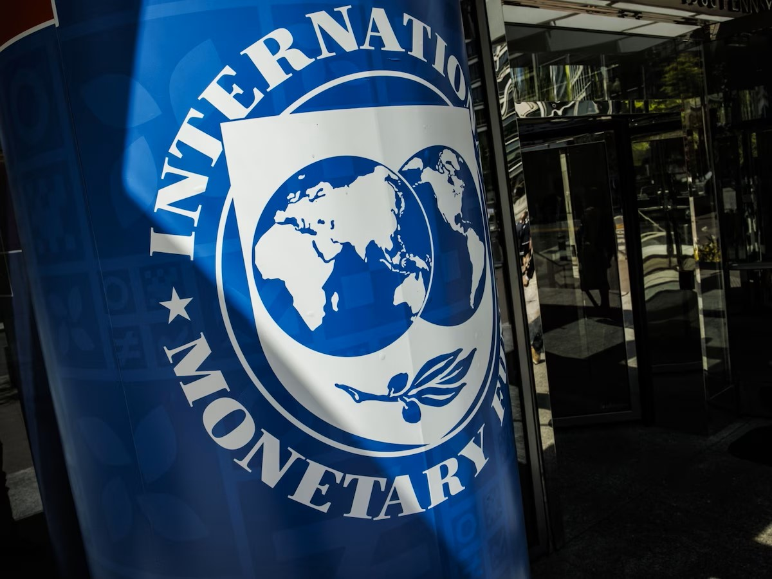
Introduction to IMF
The International Monetary Fund (IMF) is an international organization established to promote global monetary cooperation, secure financial stability, facilitate international trade, promote high employment and sustainable economic growth, and reduce poverty around the world.

Slide 3
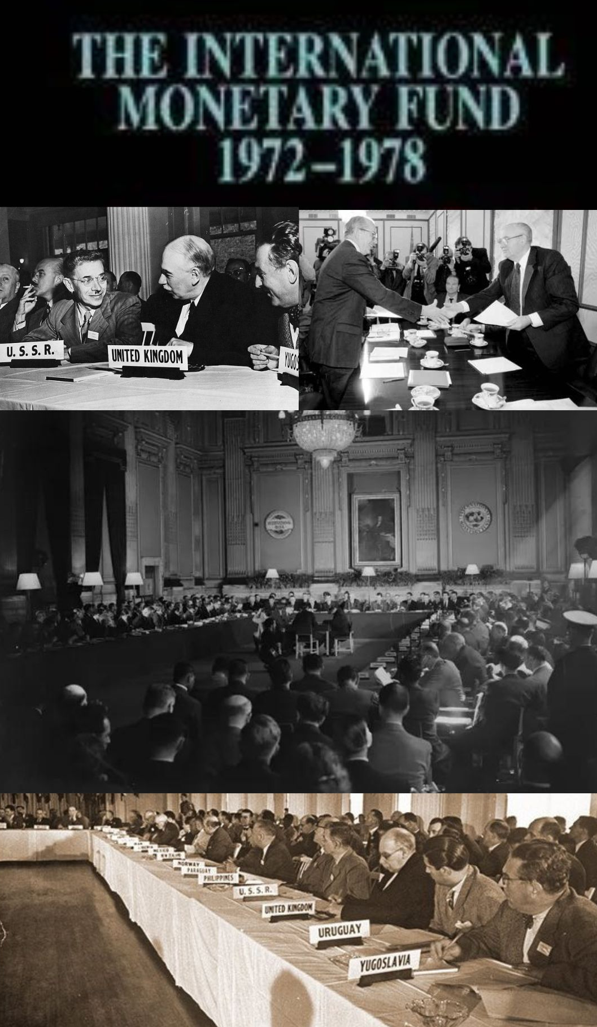

History Behind IMF formation
1
Post-World War II Economic Stability
The International Monetary Fund (IMF) was established in 1944 during the United Nations Monetary and Financial Conference.
2
Bretton Woods Agreement
Delegates from 44 Allied nations gathered at Bretton Woods, New Hampshire, USA, to create a framework for international economic cooperation.
3
Promoting Exchange Rate Stability and Economic Cooperation
The IMF's primary functions included overseeing the international monetary system, providing short-term financial assistance to countries facing balance of payments problems, and facilitating international economic cooperation.

Slide 4

Objectives of IMF
1
To promote International Monetary Cooperation
2
To reduce Disequilibrium in Balance Of Payment
3
To Ensure stability to foreign exchange
4
To provide monetary help to member country
5
To eliminate the control of exchange rate from
powerful countries

Slide 5

Function of IMF
1
IMF administer code of good behavior in international
payment
2
Provide expertise to consult decisions
3
Fixation of Par value of currencies in Gold/
4
As a financial assistance IMF offer short term loan
to make up their BOP deficit
5
To facilitates capacity development on monetary policies
aim to promote exchange rate prevent competitive devaluation
and encourage stability.

Slide 6
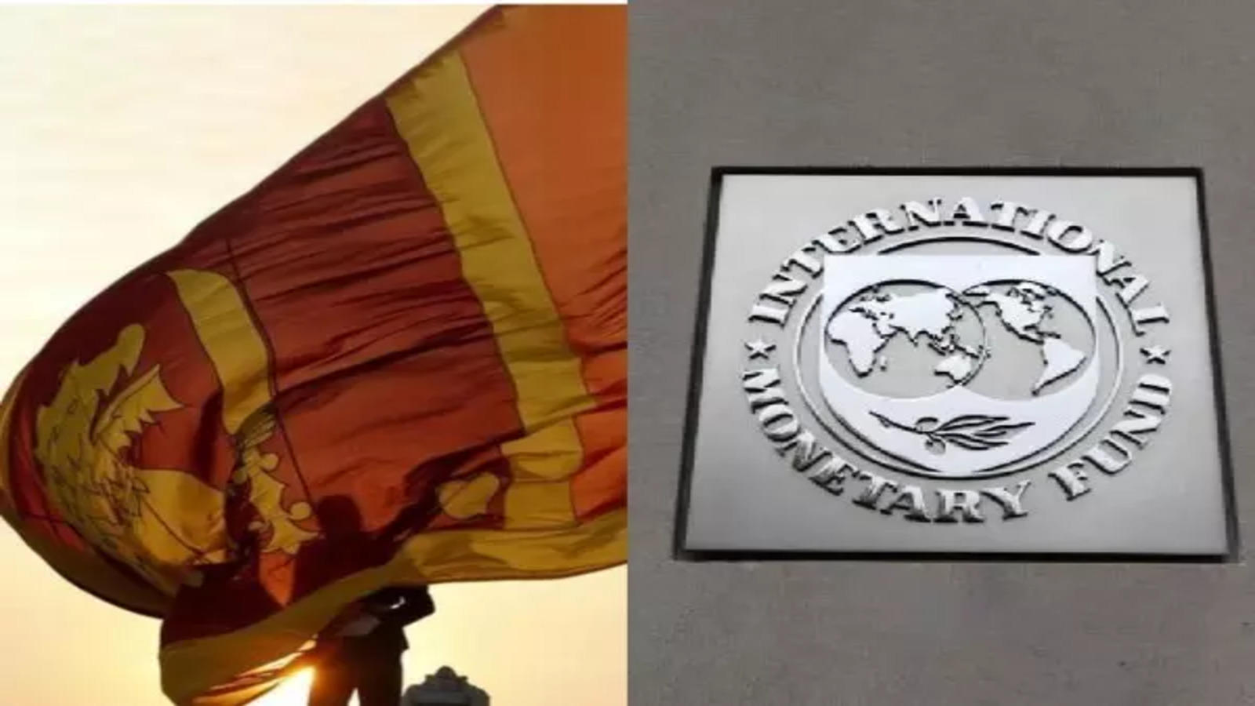
Case Study
1
Sri Lanka win initial IMF approval for $330M payout
Sri Lanka has taken steps to boost tax revenue and inflation has eased to 1.3% in September from about 50% in March, as it pushes ahead with reforms after defaulting on its debt last year. The nation needs to rebuild its foreign-exchange reserves to strengthen its buffers. Sri Lanka made some progress with its debt restructuring recently, carrying out an exchange of local debt and striking a tentative deal with the Export-Import Bank of China. A group of dollar bondholders also submitted a restructuring proposal, though it did not receive a favorable response from Sri Lanka. The country’s dollar bonds had surged more than 60% this year, as the IMF’s bailout spurred
Source : https://www.bqprime.com/business

Slide 7
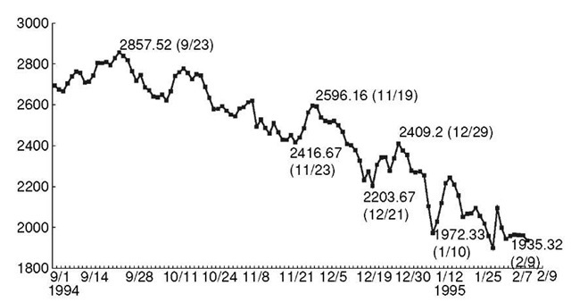
Case Study
2
Mexico Peso crisis in 1994
In the month of December, the government changed Presidents and cabinet, which resulted in a transformation of fiscal policy. Within the course of December 15 - December 21, approximately US$5.5 billion left the country, and by the end of December, the Mexican peso's devaluation was 35%. This devaluation in the matter of a couple of weeks ultimately led to interventions by the IMF and other organizations affiliated with the group. In January 1995, the IMF entered the scene and laid out a 7.8 billion bailout package that would aid Mexico in overcoming the crisis. However, the United States stepped in and increased this rescue package to US$50 billion with the aid of private banks, the IMF, and the Bank for International Settlements. As a result, this marked the first international crisis of the 21st century, and a successful instance of IMF involvement in a financial crisis.
Sources : https://www.bloomberg.com/asia

Slide 8

Sources : https://www.imf.org/en/Data

Slide 9
Causes of this Inflation analyzed from previous data
1
Black Monday 2011 to August 8, 2011 US stock market crash. Us was downgraded making it 6th largest drop of the index in history
2
Supply Chain Disruption most recently 2019-2020 COVID created widespread disruption affection industries globally shift consumer behavior.
3
Oil Prices hit 13-year low in Jan 2016, due to oversupply and weak global demand. Increased production from US and OPEC led to a surplus in global market
4
Labor Market Dynamic of South Africa in 2021 according to quarterly labor forces South Africa labor force participation increased to 58.6% in second quarter of 2022
5
Financial crisis in 2018, the Eurozone experienced debt crises. The United states had a slow recovery, market issued by Government debt debates

Slide 10

Future of IMF
1
Reducing Inequality
Inequality is the major problem. The IMF will promote policies that will help to create job, raise wages.
2
Climate changes integration
The IMF may play role in integration climatic consideration providing support
to greener economics
3
Enhanced collaboration
The IMF continue to strengthen collaboration with other
international org and government in addressing complex global economics

